Slide 1

Gamepad Development For VXINYOU
Time Box

Slide 2
目录
Catalogue
- Summary
1.1 Important Notice
1.2 Key Value Pair Introduction
- Responding to gamepad events
2.1 included keys
2.2 introduction to button response
2.3 introduction to rocker response
2.4 the flow chart for button event
2.5 the flow chart for rocker event
- Description for code examples
- Additional information
4.1 rocker introduction

Slide 3
Summary
1.1 Defination of Gamepad：
The gamepad is a device of electronic game console input by operating the buttons, to achieve the control for simulation role and others on the computer. Gamepad is designed for household game machine type, left is direction key, right possesses four to six function keys. According to the actual needs, it is possible to add more function keys to display different functions. Using gamepad is suitable for comparison categories simulator games, especially some kind of scrolling game. Almost all home consoles use gamepad to operate. WII mainframe take a new joystick, also support the GameCube-style gamepad operation.
Gamepad is always used for the kind of computer simulation, racing and etc games.
There are two words to express similar meaning of Gamepad and Joystick, and difference between them is obvious, gamepad is usually used by hand-held, Joystick is put flat on the table(just like arcade games which mainly used for arcade games simulator and flight simulator.)
1.2 Mainly function:
Each key in the gamepad has one key value that system fixed, but different gamepad with different key value. We couldn’t change their key value because of fixed well by system, but, there are many different gamepads access our platform, we couldn’t handle each time for each gamepad. So it requires us to have a fixed key value that used for all gamepads in order to ensure our program to deal with appropriate event. Firstly we have a configured key value, then convert to our own key value through our program, all gamepads can use a set of general key value finally.
The document is faced to Unity 3d developer, including clients and server engineer.

Slide 4
1.3 Neccessary interface and method：
1.5.1 Activity must implement BoxPlayCommandInterface, and need to add priviledge to generate control of gamepad
1.5.2 Monitor bluetooth: when gamepad connected, it will nofity BoxContorl， then BoxContorl will aasign the player number to the relevant gamepad. Please add BoxContorl.getInstance(getApplicationContext()) to onCreate method.
1. 1.1 The A n d r o i d version must be 4 . 0 +， otherwise it does not support the function of gamepad.
1. 1.2 Check the Bluetooth permission of A n d r o i d M a n i f e s t . x m l to prevent the loss of permission。
1. 1.3Guide into v x i n y o u s d k . j a r， otherwise you will cannot binding the key-value.
1.1.4 Support U S B function，but the equipment must have O T G function。
1.1.5 Don't make the function of right rocker the same with the left one, you can make the left same with D-pad.
1.1.6 Do not let the frame rate drops to 20 or less. When using the game controllor, if the game's frame rate is less than 20, there will be a significant Kartun. 60 is an ideal rate, but in many cases above 30 frames is also acceptable.
1.1.7 Test HDMI connectivity TV, pay attention to your application needs to handle at least two different resolutions up to 1080P and 720P
1.1.8 When the gamepad instead of the touch screen to be the main input device for a game, you can remove all touch interface elements on the screen.
1.1Important Notice

Slide 5
Attention: If Incident Response method returns true , it will not repeat the response.If return false , it will continue responding to the event. Gamepad has two models
JOYSTICK 和 JM（JOYSTICK+MOUSE）, left and right joystick will respond to two events, the amount of movement and key events. If it returns true and responds movement event, it will not respond to key event.For D-pad,L2 and R2，they can also respond to these two events, some will only respond to the key event。
Please refer to the code example description to read the details, left /right rocker and D-pad respond playJoystickGenericMotionEvent(int play, int Joystickid,int x, int y, int oldx, int
oldy)，and the keys with movements should respond （L2 and R2）playJoystickGenericMotionEventKey(int playIdx,int syskeyidx, int axisIdx, int newdata, int olddata)，L2 and R2 amy respond both events, so both of them need to deal.
For some situation, left stick and D-pad may be the same, because some gamepad default it the same as the left stick and D-pad. If you need to distinguish between them, you can judge the movement:
Joystickid=1 left stick ，Joystickid=2 right stick, Joystickid=3 D-pad 。

Slide 6
1.1.6 For control buttons to cover this method :
Public boolean dispatchKeyEvent (KeyEventevent){
/**check it is the matched gamepad or not*/
if(BoxContorl.getInstance(getApplicationContext()).dispatchKeyEvent(this, this, event)) {
return true;
} else {
return super.dispatchKeyEvent(event);
}
}
1.1.7 For control rockers to cover this method
public boolean dispatchGenericMotionEvent(MotionEvent event) {
if(BoxContorl.getInstance(getApplicationContext()).dispatchGenericMotionEvent(this, this, event)) {
return true;
} else {
return super.dispatchGenericMotionEvent(event);
}
}
1.2 instructions for key-value
public static final int KEY_COUNT = 25;
public static final int KEY_HOME = 9000;
public static final int KEY_LEFT_LEVER_UP = 9001;
public static final int KEY_LEFT_LEVER_DOWN = 9002;
public static final int KEY_LEFT_LEVER_LEFT = 9003;
public static final int KEY_LEFT_LEVER_RIGHT = 9004;
public static final int KEY_LEFT_LEVER_CENTRE = 9005;

Slide 7
public static final int KEY_L1 = 9014;
public static final int KEY_L2 = 9015;
public static final int KEY_R1 = 9016;
public static final int KEY_R2 = 9017;
public static final int KEY_RIGHT_LEVER_UP = 9018;
public static final int KEY_RIGHT_LEVER_DOWN = 9019;
public static final int KEY_RIGHT_LEVER_LEFT = 9020;
public static final int KEY_RIGHT_LEVER_RIGHT = 9021;
public static final int KEY_RIGHT_LEVER_CENTRE = 9022;
public static final int KEY_SELECT = 9023;
public static final int KEY_START = 9024;

Slide 8
Respond events of gamepad
2.1 included keys：
In summary, gamepad includes: left rocker , left cross key, L1 and L2 on the left. On the right side, there are right rocker, A ,B.X,Y, R1 and R2. In addition to, some gamepad have a START and SELECT button. About HOME key, some people make it as a system function key, but there is no HOME key in our application development. There are 14 buttons, and 25 key-value，left and right joystick will respond to two events, the amount of movement and key events, D-pad, L2 and R2 buttons can also respond to these two events, some will only respond to the key event, this is related to individual hardware.
2.2 Description for key event：
2.2.1 public boolean dispatchKeyEvent(KeyEvent event)can handle the key distribution. For the key-value that we have paired,it will caused the following situation:
1 . When you press a key, it will respond public boolean PlayKeyDown(int play, int keyCode, KeyEvent event);
2 . When loosen a key, it will respond public boolean PlayKeyUP(int play, int keyCode, KeyEvent event);
2.3 Description for rocker response：
2.3.1 public boolean dispatchGenericMotionEvent(MotionEvent event)handle the rocker and D-pad events. For the setted rocker, it will respondpublic boolean playJoystickGenericMotionEvent(int playid, MotionEvent event)to distribute the rocker events with the following methods:
1. public boolean playJoystickGenericMotionEvent(int play, int Joystickid, int x, int y, int oldx, int oldy);
2. public boolean playJoystickGenericMotionEventKey(int playIdx, int syskeyidx, int axisIdx, int newdata, int olddata);

Slide 9
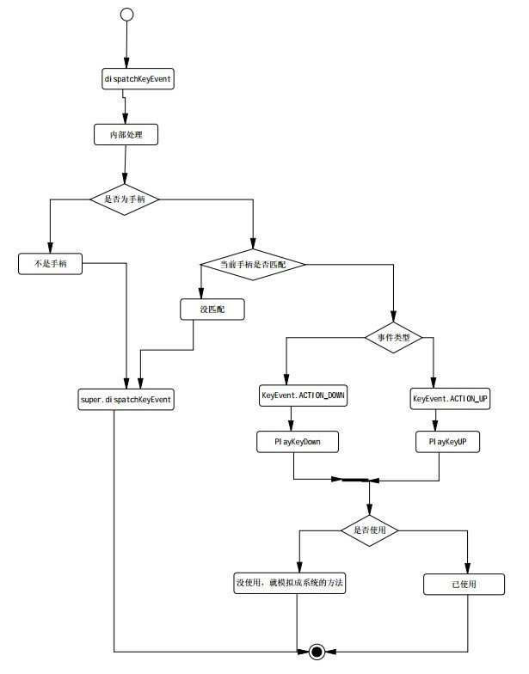
2.4 按键事件响应流程图

Slide 10
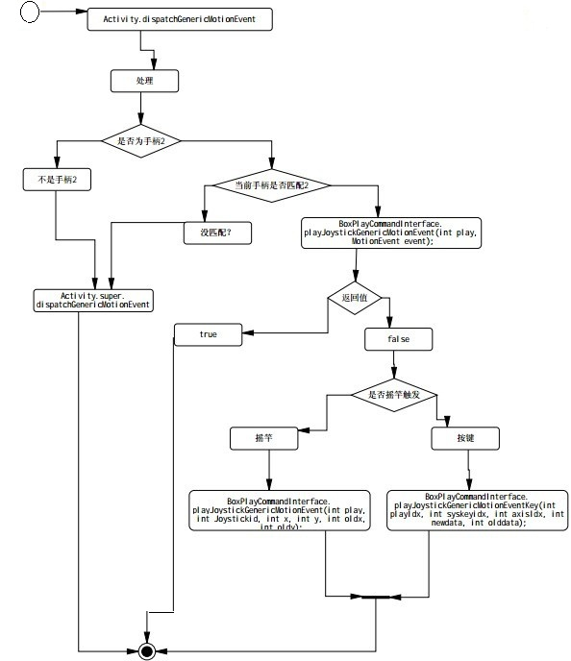
2.5 摇杆事件响应流程图

Slide 11

Description for code examples
3.1 Import vxinyousdk.jar : copy vxinyousdk.jar，click libs to paste it, The system will automatically identify, if not, can project to recompile.
3.2 Add privilege：
3.2.1 Add some privilage in AndroidManifest.xml，
<uses-permission android:name="android.permission.BLUETOOTH" />
<uses-permission android:name="android.permission.WRITE_EXTERNAL_STORAGE"/>
3.3 included methods , functions and paremeters descriptions:
Let this MainActivity inherit Activity and accomplish the related package of BoxPlayCommandInterface
import android.app.Activity;
import android.os.Bundle;
import android.view.KeyEvent;
import android.view.Menu;
import android.view.MotionEvent;
import com.vxinyou.box.tools.BoxContorl;
import com.vxinyou.box.tools.BoxPlayCommandInterface;
public class MainActivity extends Activity implements BoxPlayCommandInterface {

Slide 12
/** onCreate method deal some of the initialization*/
protected void onCreate(Bundle savedInstanceState) {
super.onCreate(savedInstanceState);
setContentView(R.layout.activity_main);
//monitor bluetooth, it will motify BoxContorl after connected with gampad，then BoxContorl will assign a player number BoxContorl.getInstance(getApplicationContext());
}
public boolean onCreateOptionsMenu(Menu menu) {
getMenuInflater().inflate(R.menu.main, menu);
BoxContorl.getInstance(getApplicationContext()).getDevcount();
return true;
}
/**If you override this method to key events, please note that the rocker will no longer trigger a rocker event after it return “true”*/
public boolean dispatchKeyEvent(KeyEvent event) {
if (BoxContorl.getInstance(getApplicationContext()).dispatchKeyEvent(this, this, event)) {
return true;
} else {
return super.dispatchKeyEvent(event);// send it to system to handle
}
}
/** For paired keys, it will deal it, otherwise to system*/
public boolean dispatchGenericMotionEvent(MotionEvent event) {
if (BoxContorl.getInstance(getApplicationContext()).dispatchGenericMotionEvent(this, this, event)) {
return true;
} else {
return super.dispatchGenericMotionEvent(event);//handled by system
}
}
/*** response for key press event*
* @param play
* 手柄号
* @param keyCode
* 对应的KeyConstants 的事件id
* @param event
* 原始的event
* @return If you do not want to make this keyboard pass on, it returns true and means is is adopted. For false ,it indicate that it will continue invoking system onkeyDown
*/
public boolean PlayKeyDown(int playid, int keycode, KeyEvent event) {
System.out.println("PlayKeyDown:playid = " + playid + " keycode=" + keycode);
return false;//It returns false and stop passing on,so that it can avoid invoking the syatem key-value
}

Slide 13
/***respond event for loosing a key
*
* @param play
* 手柄号
* @param keyCode
* 对应的KeyConstants 的事件id
* @param event
* 原始的event
* @return If you do not want to make this keyboard pass on, it returns true and means is is adopted. For false ,it indicate that it will continue invoking system onkeyDown
*/
public boolean PlayKeyUP(int playid, int keycode, KeyEvent event) {
return false;
}
/**
* corresponding rocker distribute events for gamepad:
*
* @param play
* 手柄号
* @param event
* 事件
* @return
*/
public boolean playJoystickGenericMotionEvent(int playid, MotionEvent event) {
return false;
}
/**
* Pay attention to the x and y is the floating point (-1 to + 1 ) *presision , the default precison is 100 ,and it is setted by setJoystickPrecision of BoxContorl
* x > 0 means to right x < 0 means to left<br>
* y > 0 means to up y < 0 means to downward <br>
*
* @param play
* gamepad number
* @param Joystickid
* 1 for left one, 2 for right one
* @param x
* current location for x-axis
* @param y
* current location for y-axis
* @param oldx
* old valve for x-axis
* @param oldy
* old value for y-axis
* @return
*/

Slide 14
public boolean playJoystickGenericMotionEvent(int play, int Joystickid,
int x, int y, int oldx, int oldy) {
return false;
}
/**
* movement method of key: floating point * precision <br>
*
* @param playIdx
* 手柄号
* @param syskeyidx
* KeyConstants 定义的键位号
* @param axisIdx
* MotionEvent中的 axisIdx
* @param newdata
*
* @param olddata
*
* @return
*/
@Override
public boolean playJoystickGenericMotionEventKey(int playIdx,
int syskeyidx, int axisIdx, int newdata, int olddata) {
return false;
}
}
/**
* long press event for key
*
* @param play
* 手柄号
* @param keyCode
* 对应的KeyConstants 的事件id
* @param count
* respond time
* @param event
* original event
* @return If you do not want to make this keyboard pass on, it returns true and means is is adopted. For false ,it indicate that it will continue invoking system onkeyDown
*/
public boolean PlayLongPressKeyDown(int play, int keyCode, int count, KeyEvent event){
return false;
}

Slide 15
If you need mouse function, you can call the wakeMouse() in BoxContorl，and can define either the left rocker or right rocker as mouse.Otherwise, just ignore this.
（Attention：We do not agree there is a mouse function ，only when the case of the mouse button experience over key experience，we can use this function.）
/**
* 唤醒鼠标
*
* @param activity
* current page
* @param onlyParent
* Whether it is the main gamepad effective, if not , all gamepads are valid
* @param Joystickid
* left rocker or right rocker: 1 for left, 2 for right
* @param leftKey
* left key of the mouse, if you don't need ,please fill 0
* @param rightKey
* right key of the mouse, if you don't need ,please fill 0
*/
public boolean wakeMouse(Object activity, boolean onlyParent, int Joystickid, int leftKey, int rightKey) {
if (activity instanceof BoxContorlInteface) {
int devid = 0;
if (onlyParent) {
devid = getParentDev();
}
return ((BoxContorlInteface) activity).wakeMouse(activity, devid, Joystickid, leftKey, rightKey);
}
return false;
}

Slide 16
Addition information：
4.1 Rocker instructions：
MotionEvent.AXIS_HAT_X :directional control for X
MotionEvent.AXIS_HAT_Y: directional control for Y
MotionEvent.AXIS_X: the range is from -1 to +1
MotionEvent.AXIS_Y: the range is from -1 to +1
MotionEvent.AXIS_RX : rotation range is from -1 to +1
MotionEvent.AXIS_RY : rotation range is from -1 to +1
MotionEvent.AXIS_Z : the range is from -1 to +1
MotionEvent.AXIS_RZ : the rotation angle range is from -1 to +1
In fact,the corresponding gamepad should be the following examples:
MotionEvent.AXIS_X and MotionEvent.AXIS_Y formed into a rocker
MotionEvent.AXIS_RX and MotionEvent.AXIS_RY
MotionEvent.AXIS_Z and MotionEvent.AXIS_RZ
MotionEvent.AXIS_HAT_X and MotionEvent.AXIS_HAT_Y
Generally speaking a gamepad always supports three couples of gamepad, x y; RX RY;z Rz; HAT_X HAT_Y.We just need to choose one from them.
float hatx = event.getAxisValue(MotionEvent.AXIS_HAT_X);
float haty = event.getAxisValue(MotionEvent.AXIS_HAT_Y);
float x = event.getAxisValue(MotionEvent.AXIS_X);
float y = event.getAxisValue(MotionEvent.AXIS_Y);
float rx = event.getAxisValue(MotionEvent.AXIS_RX);
float ry = event.getAxisValue(MotionEvent.AXIS_RY);
float z= event.getAxisValue(MotionEvent.AXIS_Z);
float rz = event.getAxisValue(MotionEvent.AXIS_RZ);

Slide 17
In order to reduce some unnecessary trigger, the interface has been set up the method to adjust the sensitivity and the modify returning data from float to int.
BoxPlayCommandInterface,
public boolean playJoystickGenericMotionEvent(int play, int Joystickid, int x, int y, int oldx, int oldy);
public boolean playJoystickGenericMotionEventKey(int playIdx, int syskeyidx, int axisIdx, int newdata, int olddata);
the range of int x, int y, int oldx, int oldy is the data of BoxContorl.setJoystickPrecision(int data)

